Slide 1


Adversarial Attacks on MNIST using FGSM & ART
Hands-on Practice with Adversarial Robustness Toolbox (ART)
Presented by : Reem AL-ZOUHBY August 11, 2025
Notes:
Good morning everyone! Today I'm going to show you something fascinating - how to trick artificial intelligence. We'll start with a simple dataset called MNIST, build a nearly perfect model, then completely break it with invisible attacks. But don't worry - I'll also show you how to defend against these attacks. By the end, you'll understand both how to attack and protect AI systems."
Good morning/afternoon. Today, I will present my project on adversarial attacks applied to the MNIST dataset, specifically using the Fast Gradient Sign Method (FGSM) implemented through the Adversarial Robustness Toolbox (ART). I will explain how we train a model, attack it, measure the impact, and finally defend it
ART is a Python library from the Linux Foundation AI & Data, designed to evaluate and improve the security of ML models against adversarial threats.”

Slide 2
A
Introduction (Explain MNIST Dataset)
.
Plan
Model CNN
.
B
C
FGSM ATTACK
Impacts of FGSM
D
E
Defenses

Slide 3
Introduction (Explain MNIST Dataset)
.
A
What’s MNIST??

Slide 4
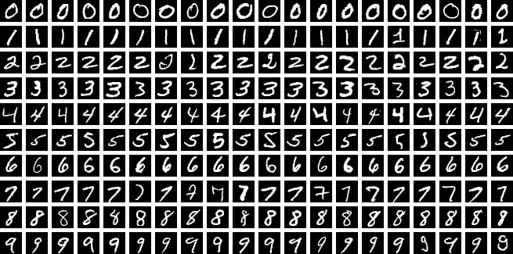
MNIST is the “Hello Word!" of computer vision
MNIST = Modified National Institute of Standards and Technology dataset.

Slide 5
A
Introduction (Explain MNIST Dataset)
.
From Pixels to Predictions
Model CNN
.
B

Slide 6
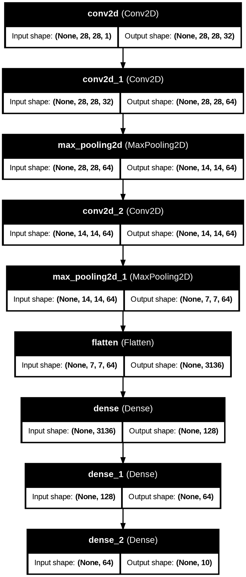
Applies 32 filters to extract simple features (edges, corners, textures) from grayscale input images
Learns more complex patterns by combining earlier features.
Reduces spatial size (downsampling), keeping important features while reducing computation..
Further refines the features; now focuses on higher-level shapes or patterns.
Downsamples again to condense the feature map before classification layers.

Slide 7

Turns the 3D feature map into a 1D vector for the dense layers.
Fully connected layer for learning high-level combinations of features.
Further condenses representation while keeping discriminative information.
Output layer with 10 neurons, one for each class, producing the final classification scores

Slide 8
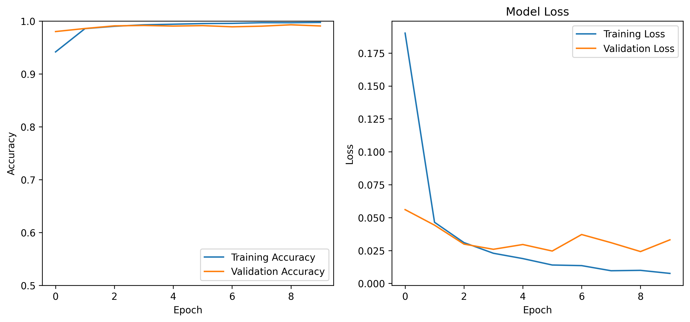

Test accuracy: 99.08%

Slide 9
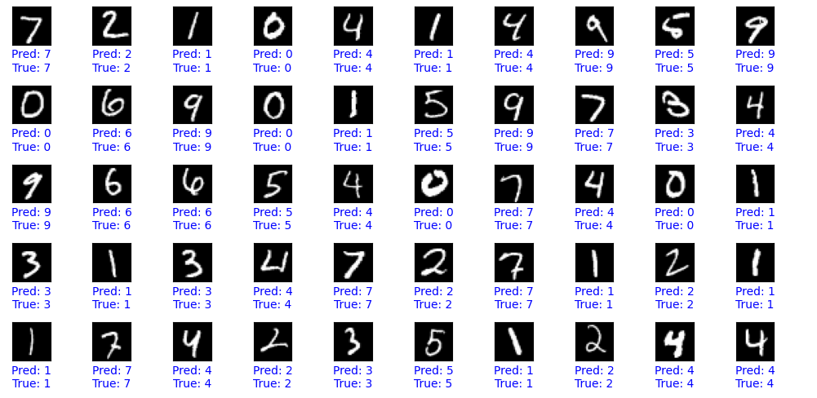

Number of correct predictions: 9908 Number of wrong prediction : 92 Total test samples: 10000

Slide 10
A
Introduction (Explain MNIST Dataset)
.
Perfect… Until We Attack
Model CNN
.
B
C
FGSM ATTACK

Slide 11

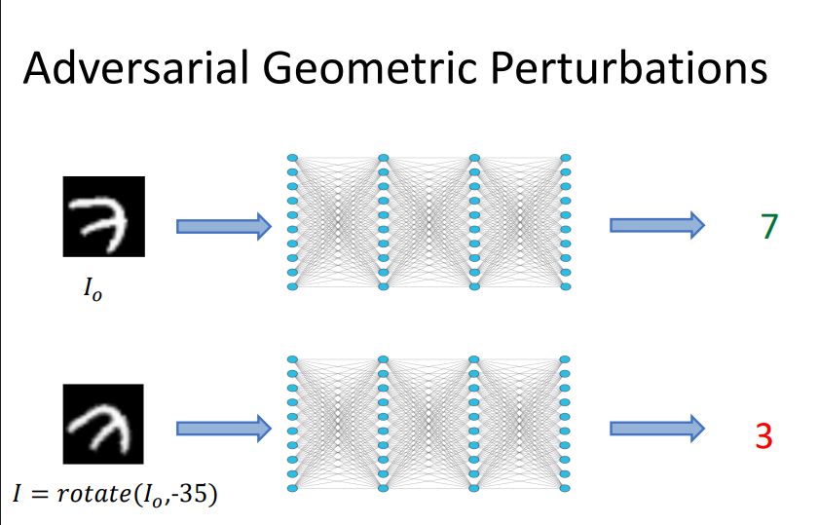
Our Model is Great… So Let’s Break It!

Slide 12
Attack using FGSM
What is FGSM?
Fast Gradient Sign Method (FGSM) is a technique to create adversarial examples by adding small perturbations to input data to fool machine learning models.
ADD ATTACK
Generates adversarial examples by adjusting pixels slightly
01
02
03
04
Mathematical Equartion
xadv​=x+ϵ⋅sign(∇x​J(θ,x,y)).
05
ART Classifier
Wrap the trained model with ART’s classifier for attack simulation.
Test for different 𝜖
Explore impact of 𝜖
ϵ values (0.05, 0.1, 0.2....

Slide 13
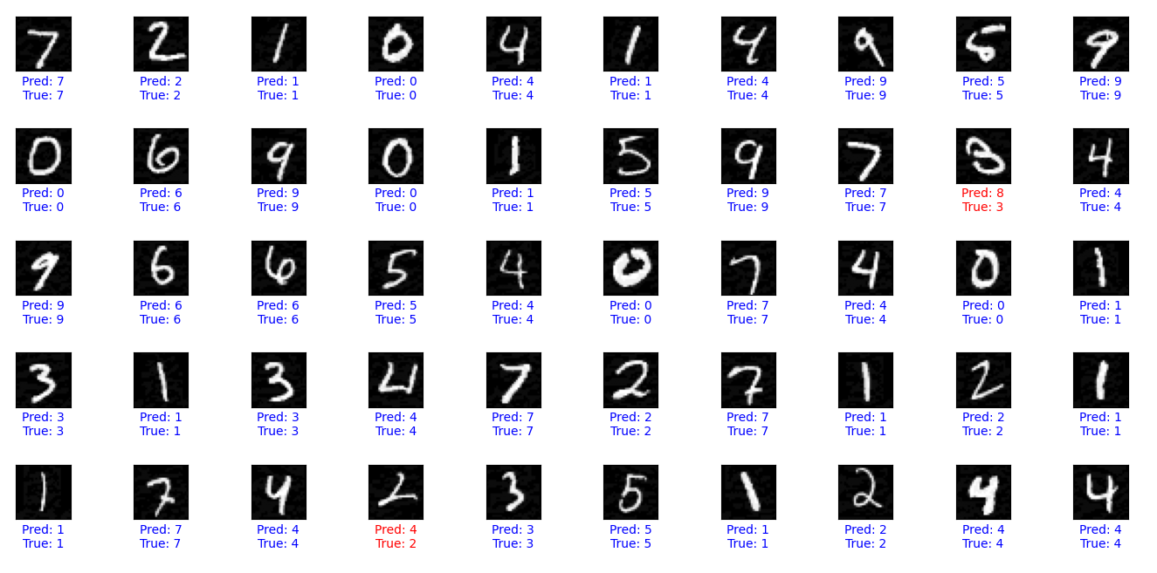
For ϵ=0.05
Accuracy on clean test examples: 0.9913 Accuracy on adversarial test examples: 0.9579 Accuracy drop due to adversarial attack: 0.0334
Number of correct predictions: 9579 Number of wrong prediction : 421 Total test samples: 10000

Slide 14
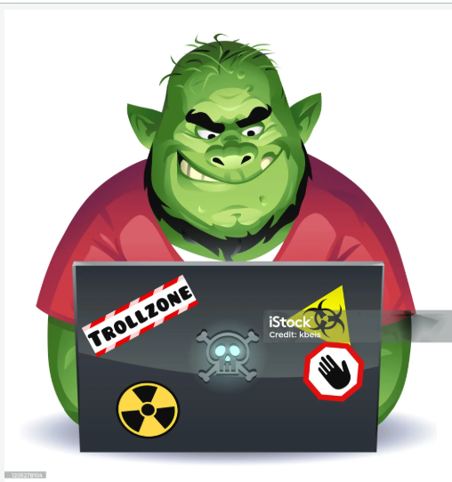
To better observe the attack’s impact, let’s increase epsilon and see how accuracy changes.

Slide 15
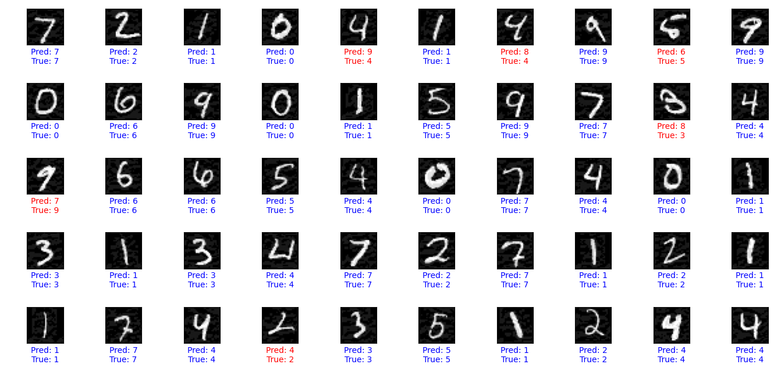
For ϵ=0.1
Accuracy on clean test examples: 0.9913
Accuracy on adversarial test examples: 0.8451
Accuracy drop due to adversarial attack: 0.1462
Number of correct predictions: 8451
Number of wrong prediction : 1549
Total test samples: 10000

Slide 16
To better observe the attack’s impact, let’s increase epsilon and see how accuracy changes.

Slide 17
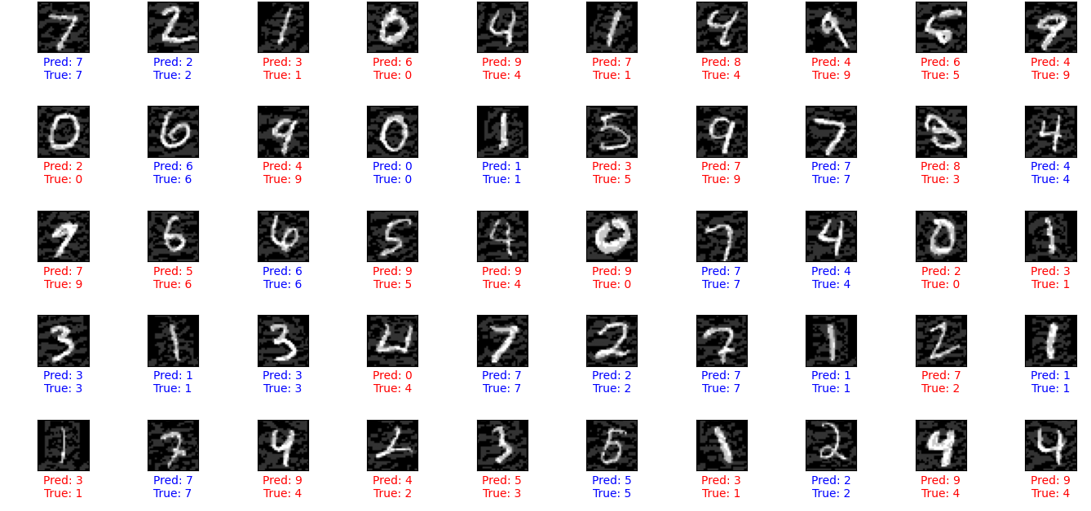
For ϵ=0.2
Accuracy on clean test examples: 0.9913
Accuracy on adversarial test examples: 0.5006
Accuracy drop due to adversarial attack: 0.4907
Number of correct predictions: 5006
Number of wrong prediction : 4994
Total test samples: 10000

Slide 18
To better observe the attack’s impact, let’s increase epsilon and see how accuracy changes.

Slide 19
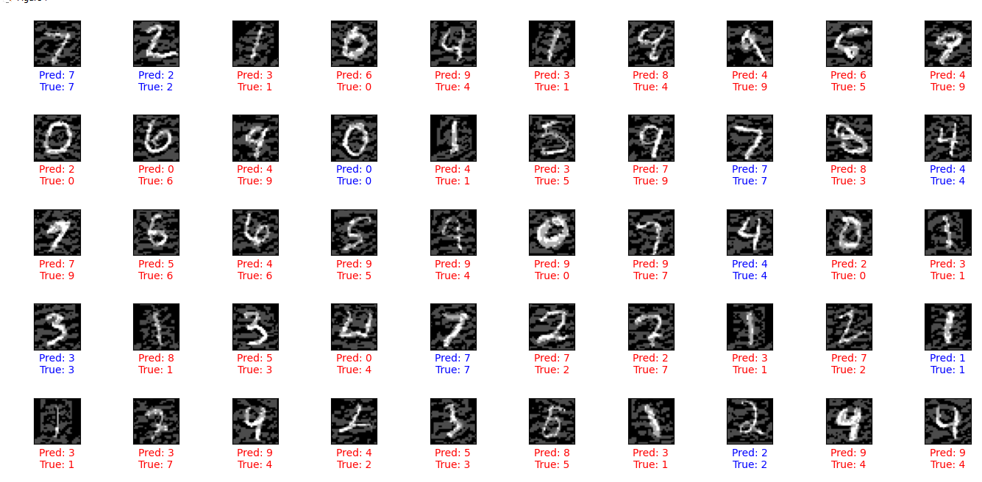
For ϵ=0.3
Accuracy on clean test examples: 0.9913
Accuracy on adversarial test examples: 0.2860
Accuracy drop due to adversarial attack: 0.7053
Number of correct predictions: 2860
Number of wrong prediction : 7140
Total test samples: 10000

Slide 20

The number of wrong predictions (7140 out of 10000) is very high, showing the attack effectively breaks the model’s performance.

Slide 21
Introduction (Explain MNIST Dataset)
.
A
How Dangerous Can Epsilon Be?
Model CNN
.
B
C
FGSM ATTACK
Impact of FGSM
D

Slide 22
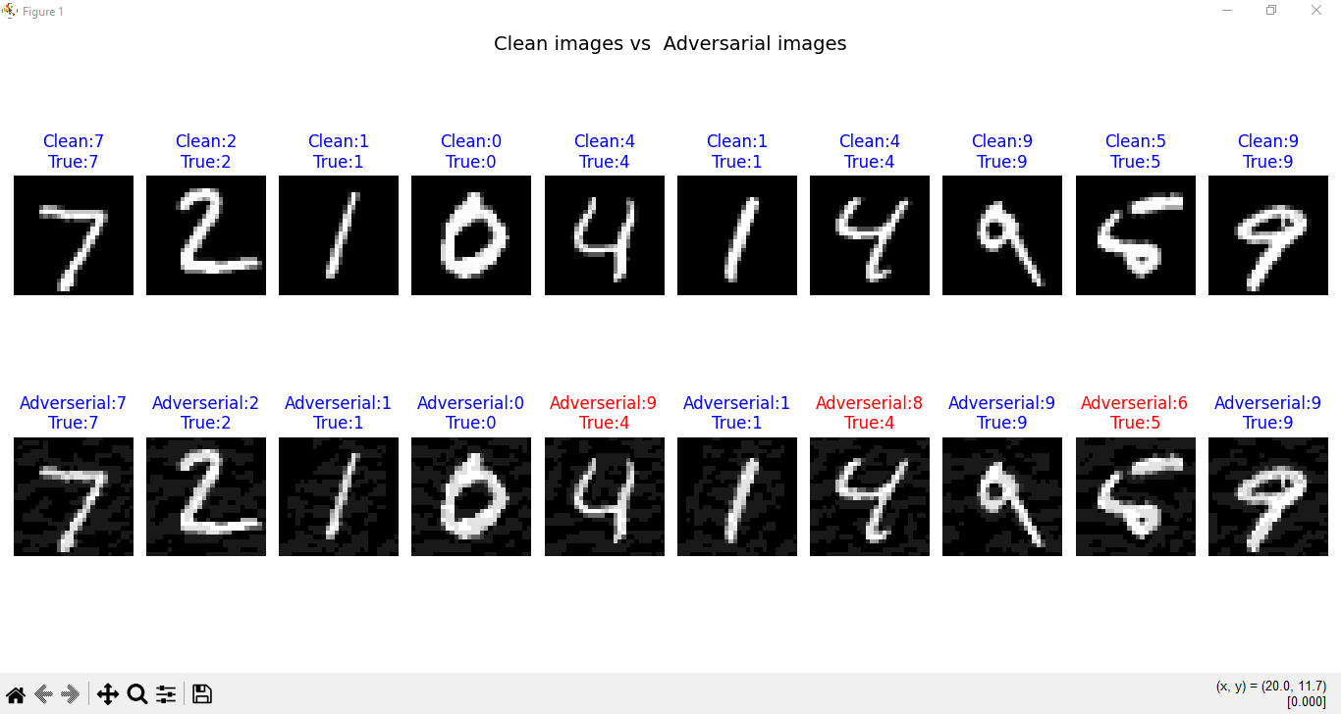

Slide 23
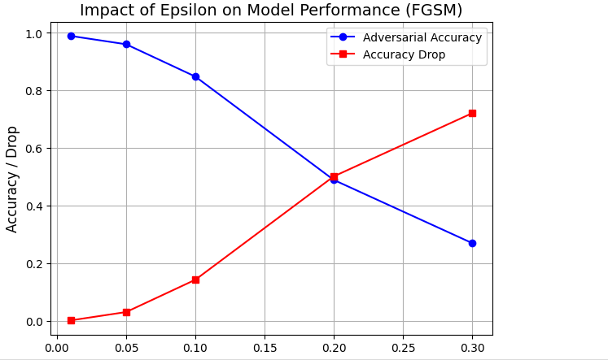
The trade-off between perturbation strength and model performance.

Slide 24


Slide 25
Introduction (Explain MNIST Dataset)
.
A
Let’s find a Solution
Model CNN
.
B
C
FGSM ATTACK
Impact of FGSM
D
E
Defense

Slide 26
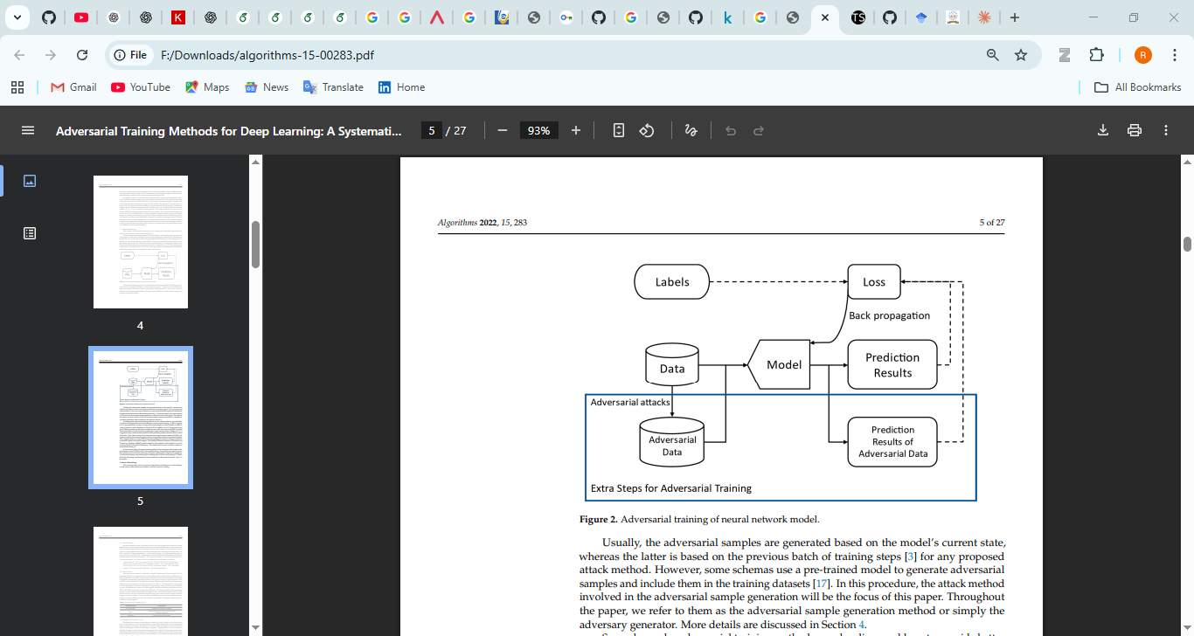
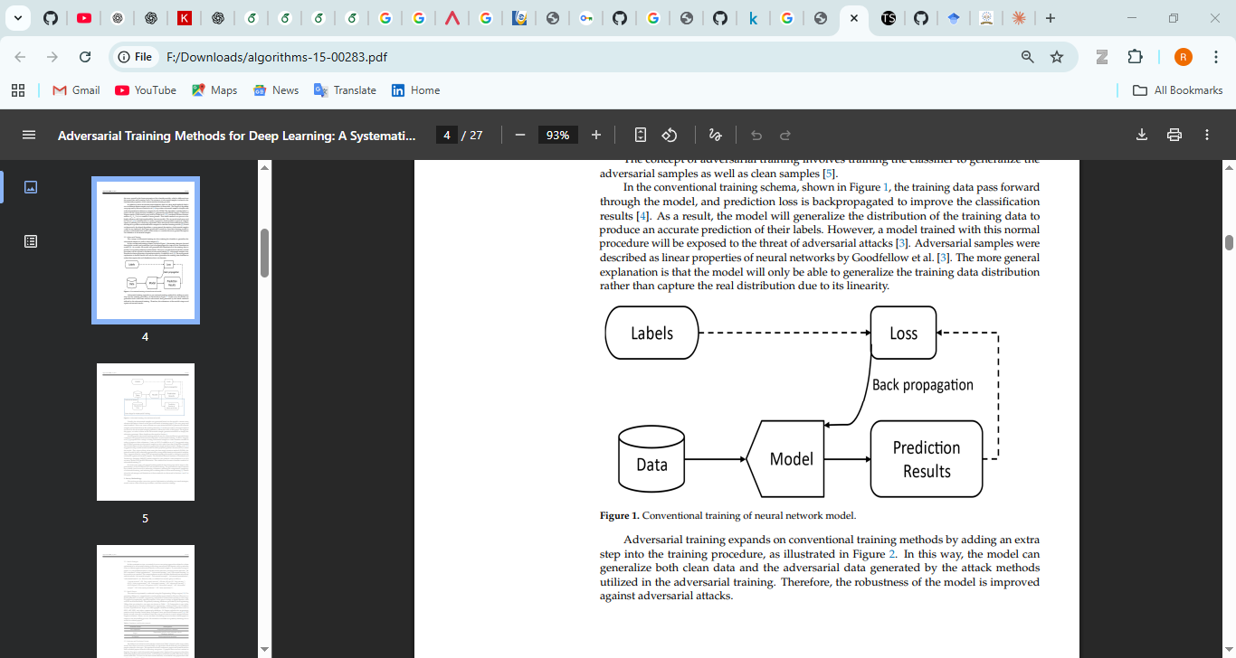

Slide 27
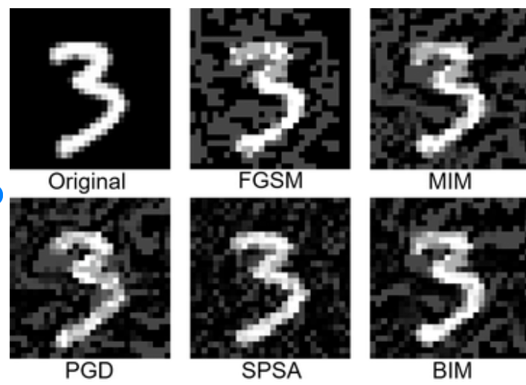
trainer = AdversarialTrainer(classifier, attack, ratio=0.5)
trainer.fit(train_images, train_labels, nb_epochs=10, batch_size=128)
We added an adversarial examples into the training dataset
Since we do an attack FGSM , we added an adversarial examples (attacks with FGSM ϵ=0.3)

Slide 28

Training accuracy after adversarial training: 95.93%
Test accuracy (clean data) after adversarial training: 95.83%

Slide 29
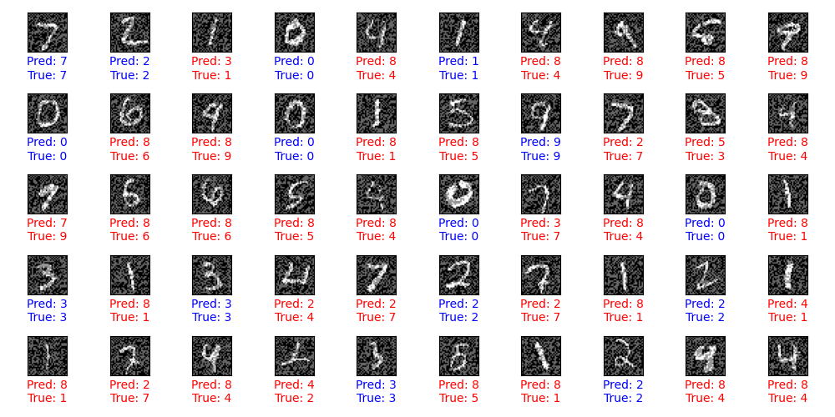
Now , let’s move to do an attacks to check if my defense is work correctly or no
With only ϵ<= 0.3 the defense is successful with ϵ=0.4 this is the results
Number of correct predictions: 4752
Number of wrong prediction : 5248
Total test samples: 10000

Slide 30
Another solution : PGD adversarial training
PGD= Project Gradient Descent
In the PGD attack, we repeat
For each iteration i:
x^(i+1) = Project_into_bounds(x^(i) + α × sign(∇_x Loss))

Slide 31


